Slide 1
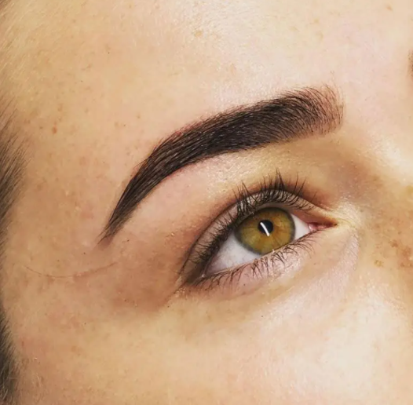
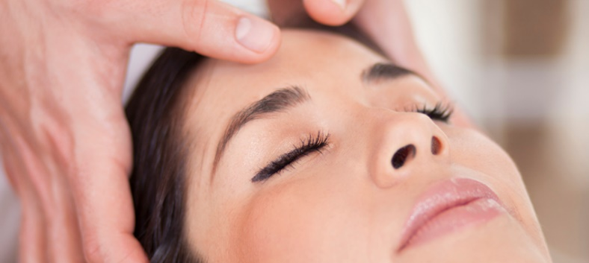
Henna Brows and Indian Head Massage are now available at our salon…
Indian Head Massage
Indian head massage is an ancient complementary therapy, based on the ayurvedic system of healing. It is a relaxing holistic which reduces stress level. It makes you feel energised with improved level of concentration. It aims to rebalance your body’s energies and improves the general hair and scalp condition.
Henna Brows
Henna Brows gives a defined eyebrow look that lasts!
Henna is a 100% organic, vegan friendly product which stains the skin for up to 2 weeks (giving an eyebrow definition or microbladed look) and the hair up to 6 weeks. Henna is nourishing for the hair, encouraging it to grow! No oxidant, so no drying out of the hair. Henna comes in around 10 shades, as well as lighteners or darkeners to create even more.

